Slide 1
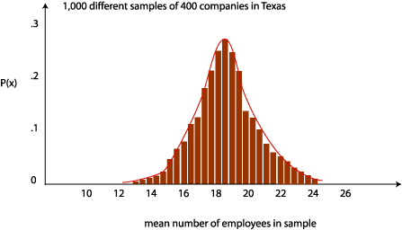
Central limit theorem
Geog4300/6300
Jerry Shannon

Slide 2
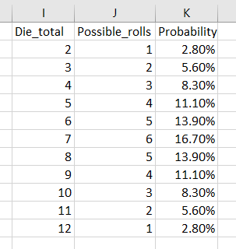
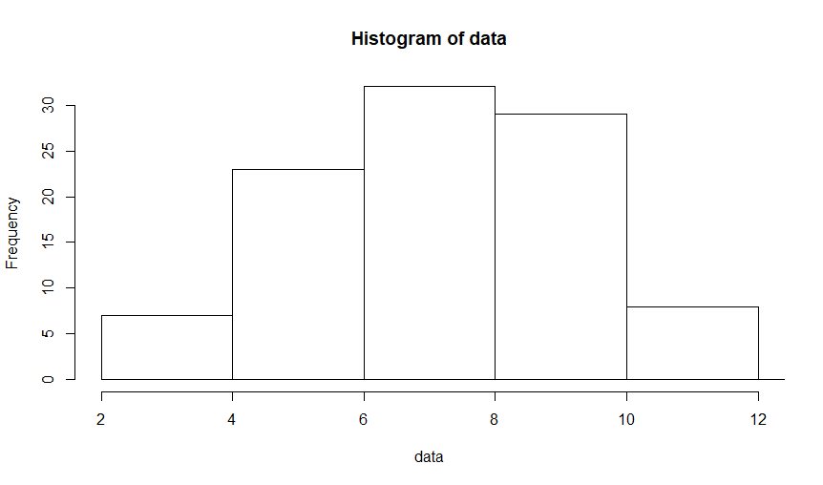
What’s the distribution of probability for rolling two dice?
Mean of 7
Standard deviation of 2.45

Slide 3
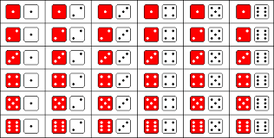
Roll the dice 10 times and record your totals
What’s your mean? What’s your standard deviation?

Slide 4

The central limit theorem:
What’s the relationship between the mean of
the sample population (your dice rolls) and
the actual population (all possible rolls)?

Slide 5
The central limit theorem describes
THREE distributions:
The actual population
Any population sample
All possible sample means

Slide 6
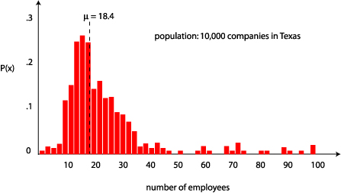
The ACTUAL population:
10,000 companies in Texas
Variable: number of employees

Slide 7
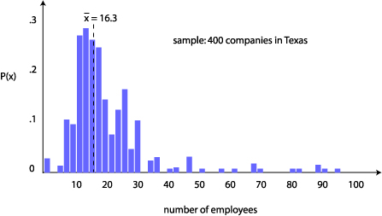
The SAMPLE population
Let’s take a sample of 400 companies.
How does this mean ( x ) compare to the actual population mean (μ)?

Slide 8

All possible SAMPLE MEANS
Now let’s take 1,000 more samples of 400 companies.
What would the distribution of their means look like? How would they compare to the actual mean?

Slide 9

Three types of distributions
Population
Sample
Sampling mean

Slide 10
What were these three distributions for our dice rolls?
Population
Sample
Sampling mean

Slide 11
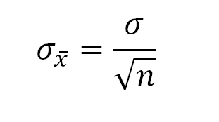
Central Limit Theorem
The sampling distribution, comprised of the means of all possible samples, will:
have a mean that is the same as the population mean
approximate a normal distribution, even if the sample distribution is not normal
have a standard deviation equal to the following formula:

Slide 12
Standard Error of the Mean
Used to estimate variability of sampling distributions
It’s the standard deviation of the sampling mean

Slide 13
Try it out!
The mean and standard deviation for all dice rolls is 7 and 2.45.
What’s the standard error of the mean for 10 dice rolls?
Go back to the means of your dice rolls. How many means fall within the standard error of 7? Or within two standard errors?

Slide 14
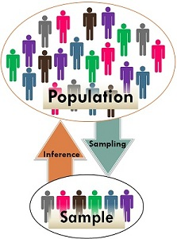
Why it matters:
The central limit theorem allows us to say something about large populations using only relatively small samples.

